Slide 1
ABAP Database Connectivity (ADBC)

Slide 2
ADBC
ADBC stands for ABAP Database Connectivity
ADBC is an object based API
It is used in ABAP applications where SAP HANA is installed as a secondary database side-by-side with the ABAP system.
For such side-by-side systems, it is recommended to use ADBC API.
It is used for native SQL calls in ABAP.
As an API, it allows for the determination of where native SQL calls are used.
It also supports exception handling.

Slide 3
Business Requirement
ADBC is flexible, object-oriented, and not difficult to use, as only two- three main classes are relevant in most cases
It allows native SQL access providing
Flexibility
Where used list
Error Handling
Main Classes are –
CL_SQL_CONNECTION
CL_SQL_STATEMENT
CL_SQL_RESULT_SET

Slide 4
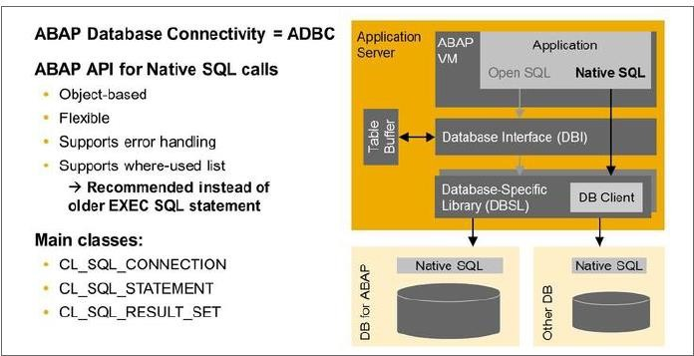
ADBC

Slide 5
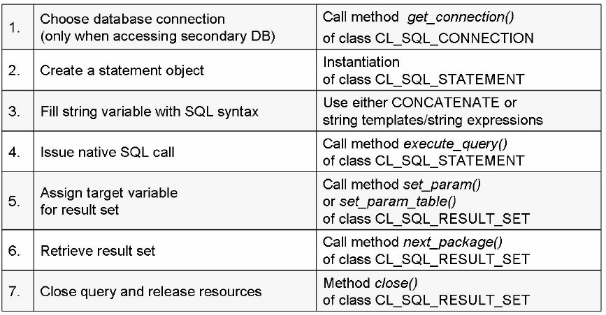
ADBC

Slide 6
ADBC
In short, the steps in the previous slide can be summarized as below
Choose database connection
cl_sql_connection=>get_connection
Instantiate the statement object
Construct the SQL (check with SQL Console for syntax)
Issue Native SQL Call
Assign target variable for result set
Retrieve Result set
Close the query and release resources

Slide 7
Disadvantages of ADBC
No hashed or sorted tables allowed as target
Use standard table
No automatic client handling
Specify MANDT in where condition
No guaranteed release of allocated resources on DB
Close the query

Slide 8
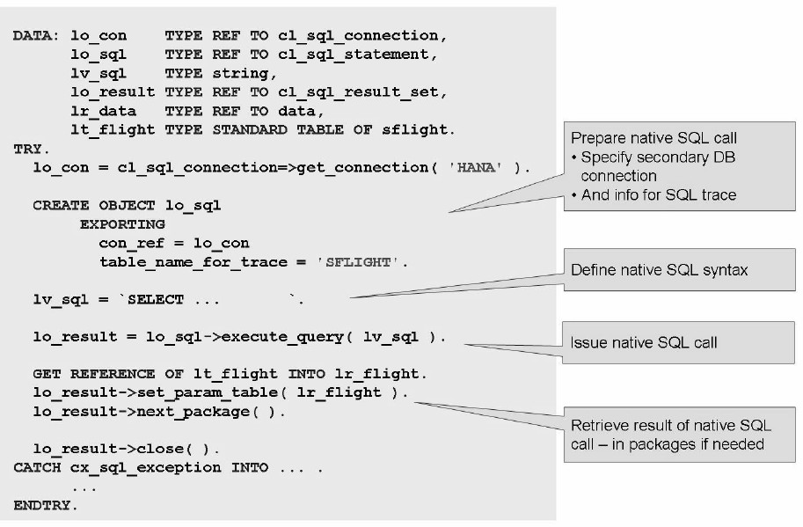
ADBC

